Slide 1
Computer Graphics:
Illumination

Slide 2
Illumination VS Shading
Illumination (lighting) model: determine the color of a surface point by simulating some light attributes.
Shading model: applies the illumination models at a set of points and colors the whole image.

Slide 3

Light plays an important part in computer graphics for rendering realistic images.
Using lighting models, we can simulate shading, reflection and refraction of light, comparable to what we see in the real world.

Slide 4
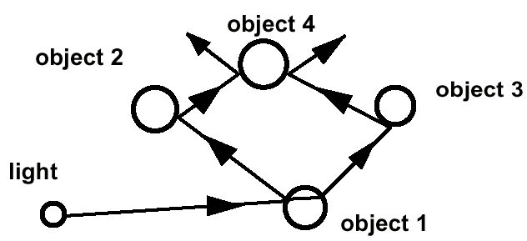
Global Light Model
Global Illumination models: take into account the interaction of light from all the surfaces in the scene.

Slide 5
Global Light Model
Global illumination refers to the interaction of light between all surfaces in a scene.
  Calculate direct light from source to object
  Calculate mutual reflection among the various objects in the scene
Huge computational complexity
Highly realistic
Example: Recursive ray tracing

Slide 6
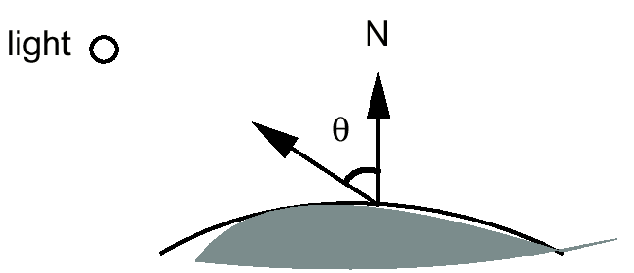
Local Light Model
Local illumination refers to direct interaction between one light source and one object surface
Only consider the light, the observer position, and the object material properties

Slide 7
Local Light Model
Simple and fast method for calculating surface intensity at a given point
Lighting calculation are based on:
  The background lighting conditions
  The light source specification: color, position
  Optical properties of surfaces:
    Glossy OR matte
    Opaque OR transparent (control refection and absorption)

Slide 8
Local Light Model
Only compute direct light from source to object
Avoid mutual reflections
For lighting the scene assume constant ambient light
Less mathematical cost
Reduced realism
TRADEOFF: Use local model in graphics and animation.

Slide 9
Contents
Today we will start to look at illumination models in computer graphics
  Why do we need illumination models?
  Different kinds of lights
  Different kinds of reflections
  Basic lighting model

Slide 10

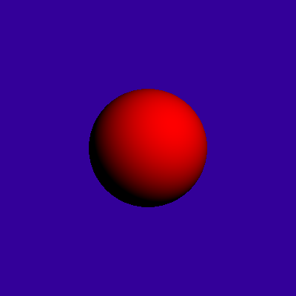
Why Lighting?
If we don’t have lighting effects nothing looks three dimensional!

Slide 11
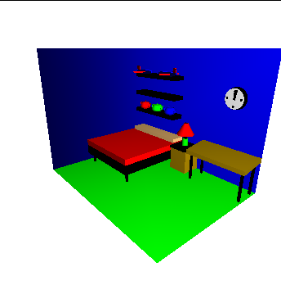
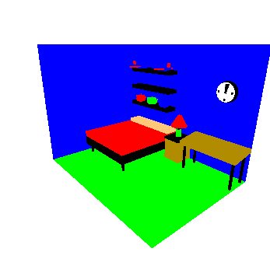
Why Lighting? (cont…)

Slide 12
Surface Lighting Effects
The amount of incident light reflected by a surface depends on the type of material
Shiny materials reflect more of the incident light and dull surfaces absorb more of the incident light
For transparent surfaces some of the light is also transmitted through the material

Slide 13
Global Illumination by Local Light Model
Ambient reflection:
Crude approximation to global effects of light.
Accounts for the general brightness in a scene from light scattering in all directions from all surfaces.

Slide 14
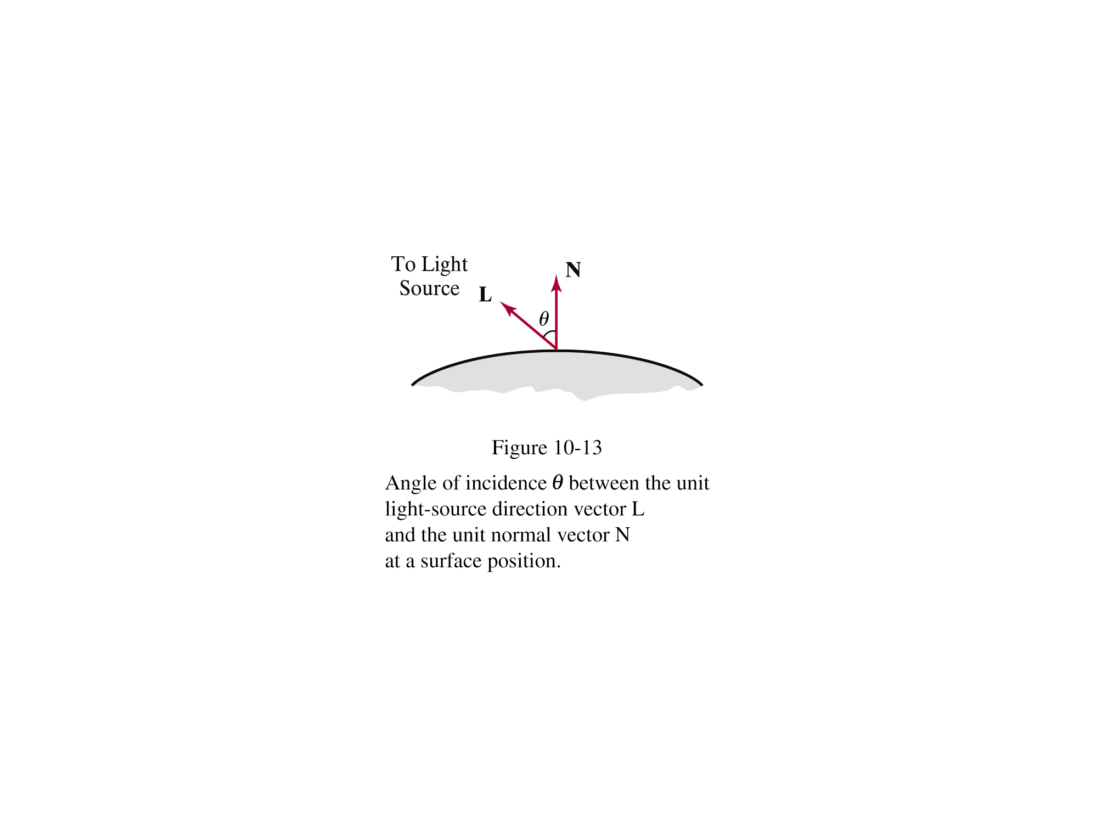
Diffuse Reflection
Surfaces that are rough or grainy tend to reflect light in all directions
This scattered light is called diffuse reflection

Slide 15
Specular Reflection
Additionally to diffuse reflection some of the reflected light is concentrated into a highlight or bright spot
This is called specular reflection

Slide 16

Ambient Light
A surface that is not exposed to direct light may still be lit up by reflections from other nearby objects – ambient light
The total reflected light from a surface is the sum of the contributions from light
sources and reflected
light

Slide 17
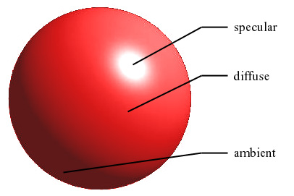
Example

Slide 18
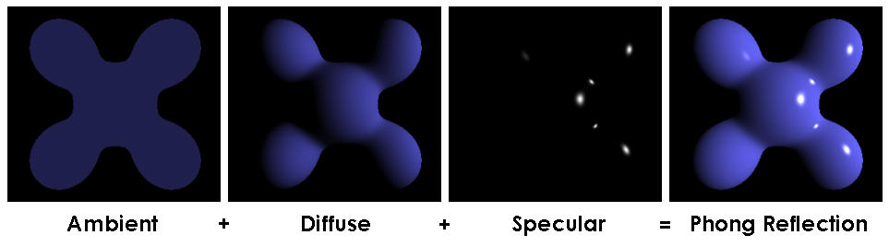
Example
Ambient
Diffuse
Final
Image
Specular

Slide 19
Basic Illumination Model
We will consider a basic illumination model (using local light model) which gives reasonably good results and is used in most graphics systems
The important components are:
  Ambient light
  Diffuse reflection
  Specular reflection
For the most part we will consider only monochromatic light
Illumination equation: I=k_{i}
I is resulting illumination and k_{i} is intrinsic intensity

Slide 20
Ambient Light
To incorporate background light we simply set a general brightness level for a scene
This approximates the global diffuse reflections from various surfaces within the scene
We will denote this value as I_{a}
And the illumination equation becomes
I=I_{a} . Ka (i)

Slide 21
Diffuse Reflection
First we assume that surfaces reflect incident light with equal intensity in all directions
Such surfaces are referred to as ideal diffuse reflectors or Lambertian reflectors

Slide 22
Diffuse Reflection (cont…)
A parameter k_{d} is set for each surface that determines the fraction of incident light that is to be scattered as diffuse reflections from that surface
This parameter is known as the diffuse-reflection coefficient or the diffuse reflectivity
k_{d} is assigned a value between 0.0 and 1.0
  0.0: dull surface that absorbs almost all light
  1.0: shiny surface that reflects almost all light

Slide 23
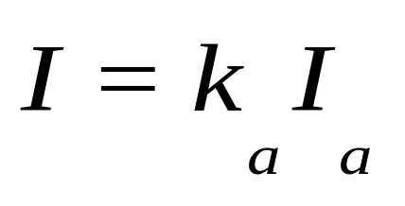
Diffuse Reflection – Ambient Light
For background lighting effects we can assume that every surface is fully illuminated by the scene’s ambient light I_{a}
Therefore the ambient contribution to the diffuse reflection is given as:
Ambient light alone is very uninteresting so we need some other lights in a scene as well

Slide 24
Diffuse Reflection (cont…)
When a surface is illuminated by a light source, the amount of incident light depends on the orientation of the surface relative to the light source direction

Slide 25

Diffuse Reflection
The angle between the incoming light direction and a surface normal is referred to as the angle of incidence given as θ
Images taken from Hearn & Baker, “Computer Graphics with OpenGL” (2004)

Slide 26
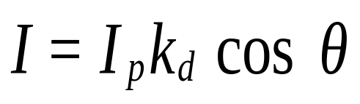
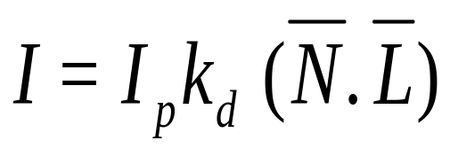
Diffuse Reflection (cont…)
So the amount of incident light on a surface for diffuse reflections can be modelled as:
For normalized N and L cosθ becomes:
(ii)

Slide 27

Diffuse Reflection (cont…)
Assuming we denote the
normal for a surface as N
and the unit direction
vector to the light source
as L then:
So:
Images taken from Hearn & Baker, “Computer Graphics with OpenGL” (2004)

Slide 28
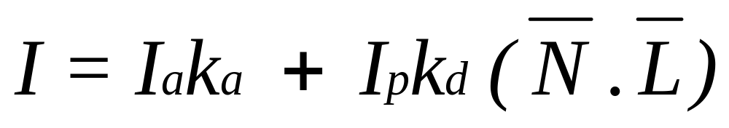
Combining Ambient And Incident Diffuse Reflections
By combining the diffuse reflections arising from ambient and incident light
  k_{a} for ambient light
  k_{d} for incident light
The total diffuse reflection equation for a single point source can then be given as:
(iii)

Slide 29
Point Light Sources
A point source is the simplest
model we can use for a light
source
We simply define:
  The position of the light
  The RGB values for the colour of the light
Light is emitted in all directions
Useful for small light sources

Slide 30
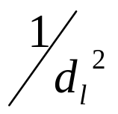
Light Source Attenuation
As light moves from a light source its intensity diminished
At any distance d_{l} away from the light source the intensity diminishes by a factor of
However, using the factor does not produce very good results so we use something different

Slide 31
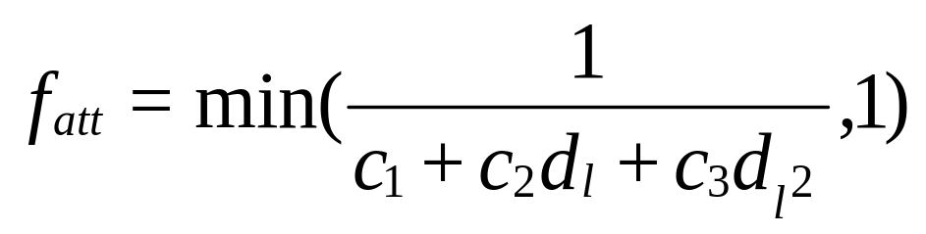
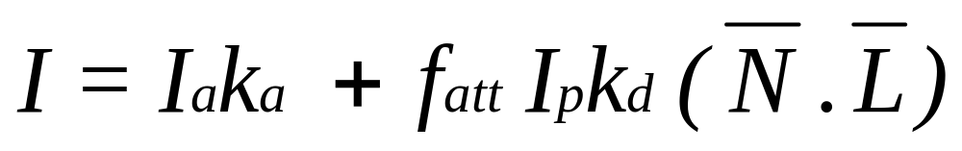
Light Source Attenuation (cont…)
We use instead in inverse quadratic function of the form:
where the coefficients c₁, c₂, and c₃ can be varied to produce optimal results
Hence the illumination equation:
(iv)

Slide 32

Reflected Light
The colours that we perceive are determined by the nature of the light reflected from an object
For example, if white
light is shone onto a
green object most
wavelengths are
absorbed, while green
light is reflected from
the object
White Light
Colours Absorbed
Green Light

Slide 33
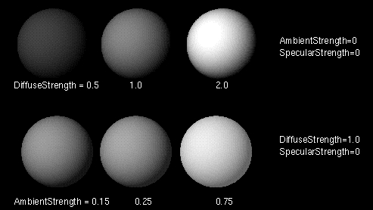
Examples

Slide 34
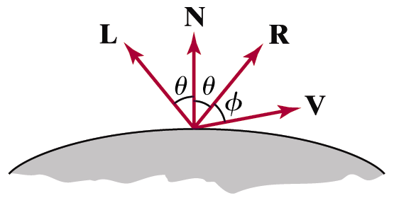
Specular Reflection
The bright spot that we see on a shiny surface is the result of near total of the incident light in a concentrated region around the specular reflection angle
The specular reflection angle equals the angle of the incident light
Images taken from Hearn & Baker, “Computer Graphics with OpenGL” (2004)

Slide 35
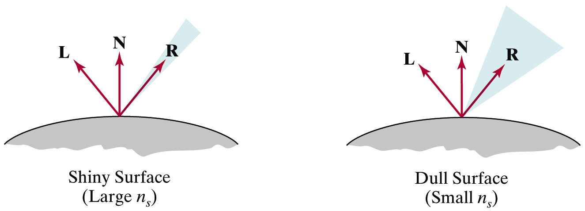
Specular Reflection (cont…)
A perfect mirror reflects light only in the specular-reflection direction
Other objects exhibit specular reflections over a finite range of viewing positions around vector R
Images taken from Hearn & Baker, “Computer Graphics with OpenGL” (2004)

Slide 36
The Phong Specular Reflection Model
The Phong specular reflection model or Phong model is an empirical model for calculating specular reflection range developed in 1973 by Phong Bui Tuong
The Phong model sets the intensity of specular reflection as
proportional to the angle
between the viewing
vector and the specular
reflection vector
Images taken from Hearn & Baker, “Computer Graphics with OpenGL” (2004)

Slide 37
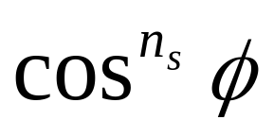
The Phong Specular Reflection Model (cont…)
So, the specular reflection intensity is proportional to
The angle Φ can be varied between 0° and 90° so that cosΦ varies from 1.0 to 0.0
The specular-reflection exponent, n_{s} is determined by the type of surface we want to display
  Shiny surfaces have a very large value (>100)
  Rough surfaces would have a value near 1

Slide 38
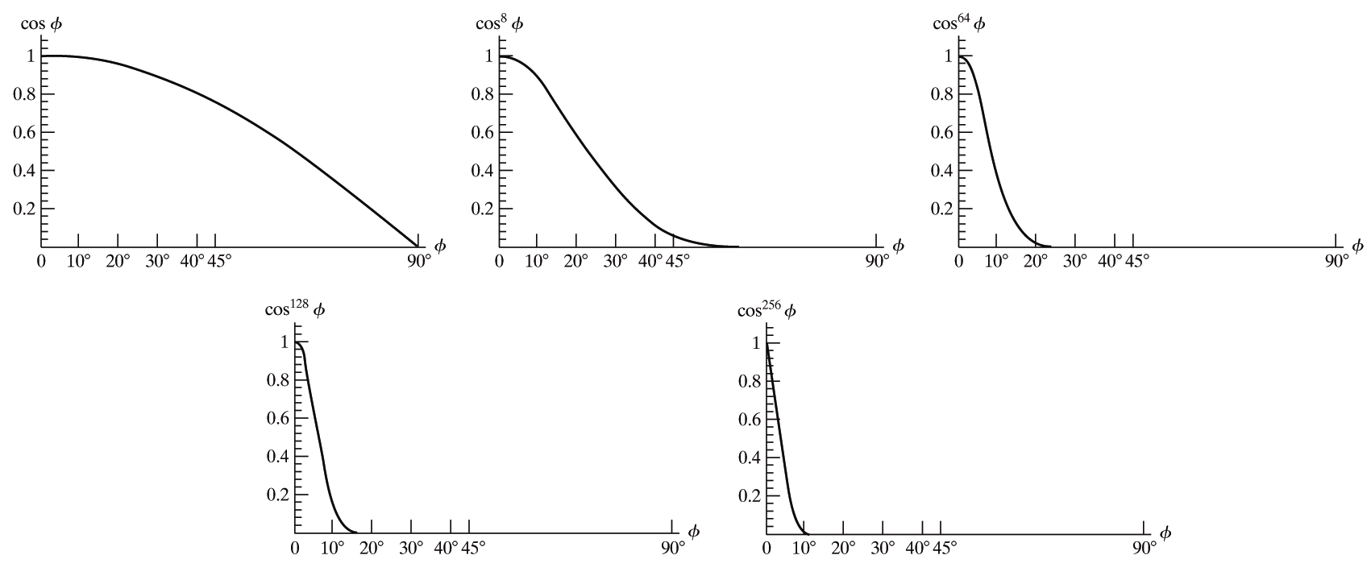
The Phong Specular Reflection Model (cont…)
The graphs below show the effect of n_{s} on the angular range in which we can expect to see specular reflections
Images taken from Hearn & Baker, “Computer Graphics with OpenGL” (2004)

Slide 39
The Phong Specular Reflection Model (cont…)
For some materials the amount of specular reflection depends heavily on the angle of the incident light
Fresnel’s Laws of Reflection describe in great detail how specular reflections behave
However, we don’t need to worry about this and instead approximate the specular effects with a constant specular reflection coefficient k_{s}

Slide 40
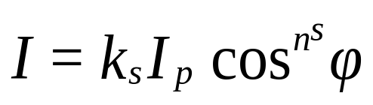
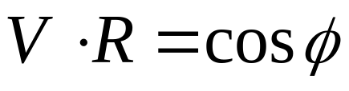
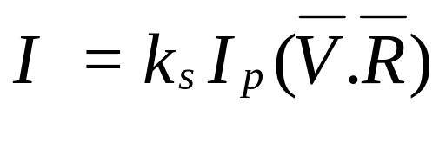
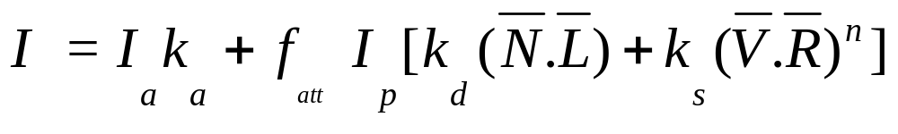
The Phong Specular Reflection Model (cont…)
So the specular reflection intensity is given as:
For normalized V and R:
And the illumination equation
This is also known as Phongs Model

Slide 41
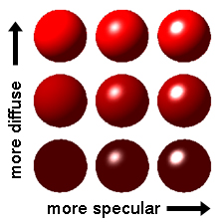
Example

Slide 42
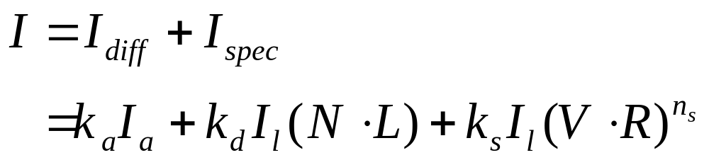
Combining Diffuse & Specular Reflections
For a single light source we can combine the effects of diffuse and specular reflections simply as follows:

Slide 43
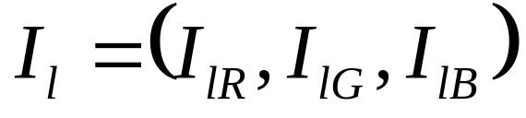
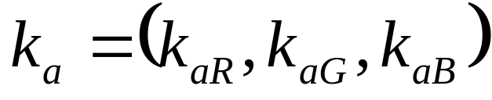
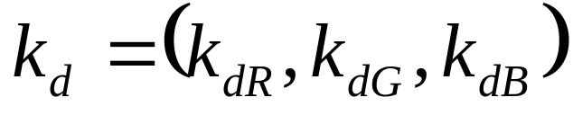

RGB Colour Considerations
For an RGB colour description each intensity specification is a three element vector
So, for each light source:
Similarly all parameters are given as vectors:

Slide 44
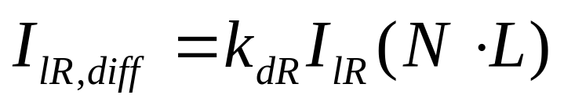
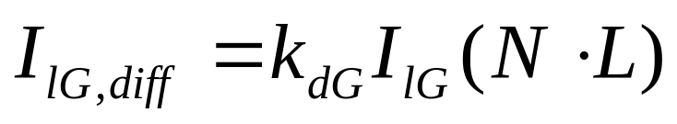

RGB Colour Considerations (cont…)
Each component of the surface colour is then calculated with a separate expression
For example:

Slide 45
Summary
To create realistic (or even semi-realistic) looking scenes we must model light correctly
To successfully model lighting effects we need to consider:
  Ambient light
  Diffuse reflections
  Specular reflections

Slide 46
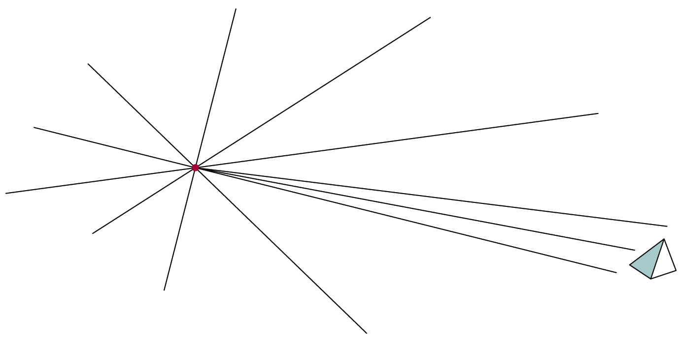
Infinitely Distant Light Sources
A large light source, like the sun, can be modelled as a point light source
However, it will have very little directional effect
Light source att. is not used atmospheric att. used
Images taken from Hearn & Baker, “Computer Graphics with OpenGL” (2004)

Slide 47
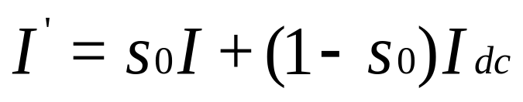
Atmospheric attenuation
Depth cueing: More distant objects are rendered with lower intensity than closer ones
Images taken from Hearn & Baker, “Computer Graphics with OpenGL” (2004)

Slide 48
Exercise
Calculate the intensity of reflected light at a point (20, 15, 100) on a sphere when I_{a}=0.2, k_{a}=0.5, I_{s}=0.8 and k_{d}=0.6. Assume the light source is at (50, 30, 500)

